Slide 1
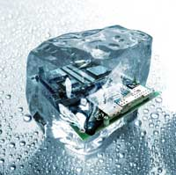
Design pattern Introduction
Hoa Vo
Quan Tran
2015.09.26

Slide 2
Software issue
Problems when developing software
Readable
Maintainable
Scalable
Testable
…

Slide 3
How it make
SEs (Software Engineers) tried to solve
They collected the good designs which solve the general problems.
In 1987, Kent Beck and Ward Cunningham began experimenting with the idea of applying patterns to programming.

Slide 4
What
Represent the best practices used by experienced object-oriented software developers
Solve general problems that software developers faced during software development
These solutions were obtained by trial and test by numerous software developers.

Slide 5
Why
Speed up the development
Prevent “Reinventing the wheel”
Save a lot of effort for designing
Improve code quality

Slide 6
Type
Creational
Behavioral
Structural

Slide 7
Creational
Abstract Factory
Factory Method
Prototype
Builder
Singleton

Slide 8
Structural
Adapter
Composite
Bridge
Decorator
Facade
Flyweight
Proxy

Slide 9
Behavioral
Chain of Resp.
Command
Interpreter
Iterator
Observer
Strategy
…

Slide 10
Practice
Let code

Slide 11
OOP concepts
OOP concepts: Abstract class, interface, inheritance, polymorphism … use for ??

Slide 12
Singleton pattern
What :
Create only one instance of a class
Why :
Save the memory
Easy to use
Solve the synchronization issue
Kinds :
Early Instantiation : create the instance once when class loaded
Laze instantiation : create the instance once at the first time required

Slide 13
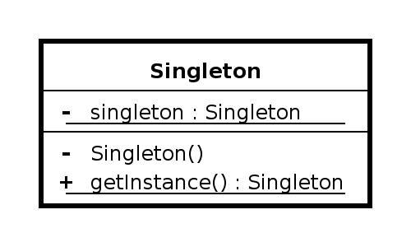
Singleton pattern
How
The static member : hold the instance
The static getter : allow other classes can get the instance.
The private constructor: prevent other classes create new instances.

Slide 14
Singleton pattern
Example
class Database{
private static Database instance = new Database();
public static Database getInstance(){
return instance;
}
private Database(){}
public void doSomething(){ }
}
Database.getInstance().doSomething();

Slide 15
Singleton pattern
Example
class Database2{
private static Database2 instance;
public synchronized static Database2 getInstance(){
if(instance==null){instance = new Database2(); }
return instance;
}
private Database2(){ }
public void doSomething(){ }
}
Database.getInstance().doSomething();

Slide 16
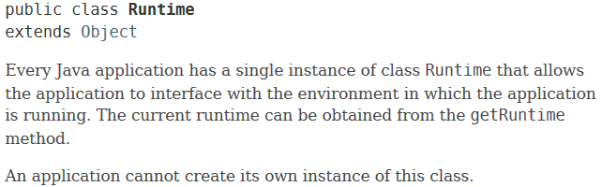

Singleton pattern
Real example
Class Runtime (J2SE)

Slide 17
Factory Pattern
What :
Making a “factory” to create objects
Why :
Easy to create many similar objects from many similar classes
Easy to extend a system

Slide 18
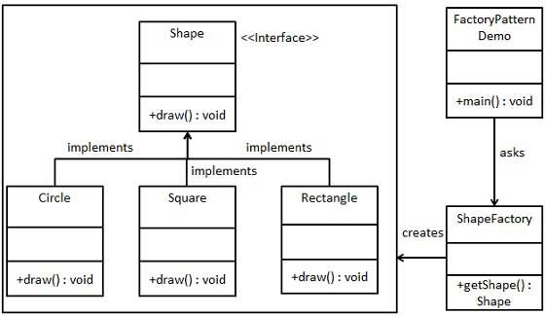
Factory Pattern
Example

Slide 19

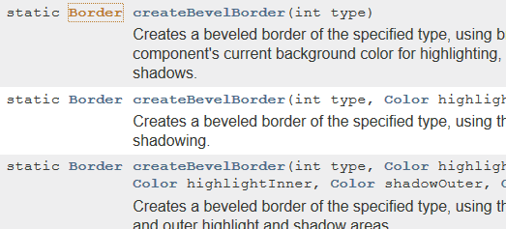
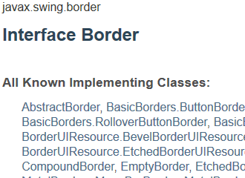
Factory Pattern
Real example
https://docs.oracle.com/javase/7/docs/api/javax/swing/BorderFactory.html

Slide 20
Facade
Facade
(fəˈsɑːd)

Slide 21
When
The system is very complex or difficult to understand
System has a large number of interdependent classes

Slide 22
How
Hides the complexities of the system
Provides an interface to the client using which the client can access the system

Slide 23
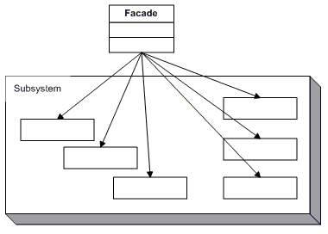
UML

Slide 24
Practice
Let code

Slide 25
Observer
Observer

Slide 26
When
An object want to notify other objects automatically

Slide 27
How
Calling one of their methods

Slide 28
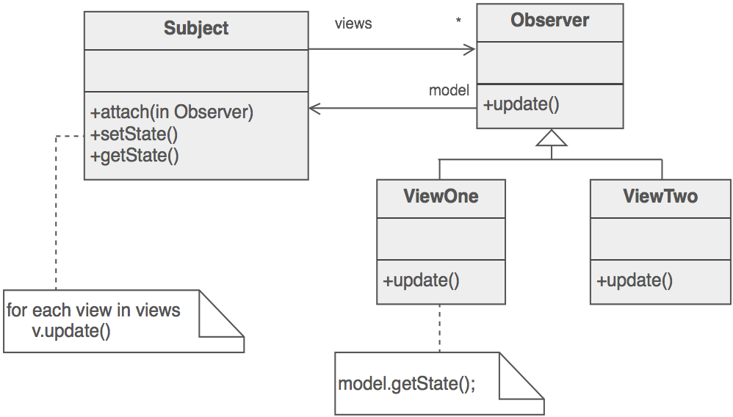
UML

Slide 29
Practice
Let code

Slide 30
Behavioral
Strategy

Slide 31
When
Have a family of implementation
Make them interchangeable

Slide 32
How
Capture the abstraction in an interface
Bury implementation details in derived classes

Slide 33
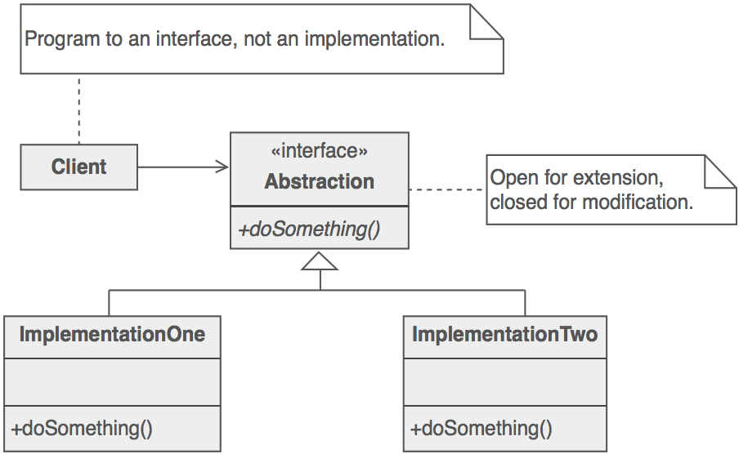
UML

Slide 34
Practice
Let code

Slide 35
Command pattern
What
Encapsulate a request as an object
Why
Easy to add/remove actions
Make a call-back

Slide 36
Command pattern
How
Command : an interface with a method name “Execute”
ConcreteCommand : Implement Command
Invoker : store all ConcreteCommand objects and execute all commands
Receiver : Handle the commands
Client : the main point of your application

Slide 37
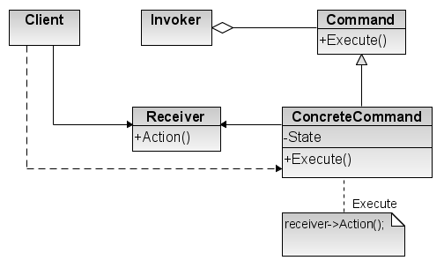
Command pattern
UML

Slide 38
Practice
Let code

Slide 39
Behavioral
Iterator

Slide 40
When
Need a way to access the elements of an aggregate object sequentially

Slide 41
How
Hide all element inside container
The container provide interface to access element

Slide 42
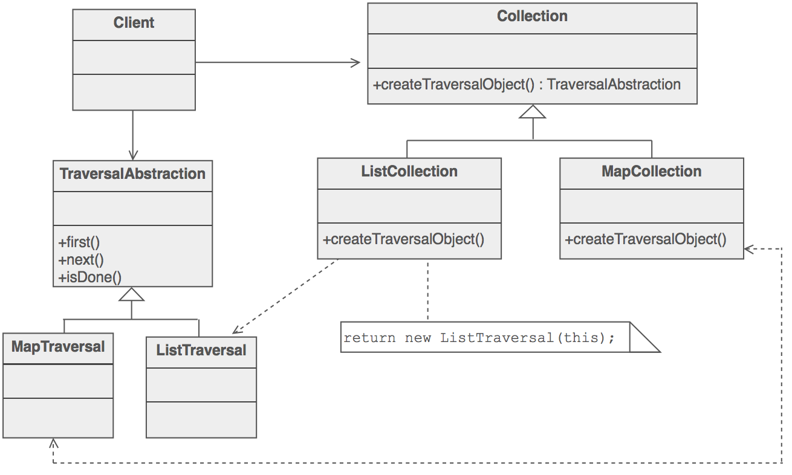
UML

Slide 43
Practice
Let code

Slide 44

Question & Answer
Any questions ?

Slide 45




Thank for your attention
www.sioux.asia
+84 (0) 5113888756
contact@sioux.asia

